Slide 1
Buildings in the EPBD & EED – What opportunities for the revisions?
Arianna Vitali Roscini
WWF European Policy Office
10 March 2017
© Nigel Dickinson / WWF-Canon

Slide 2
Outline of the presentation
Improve definition of decarbonised building stock
Introduce renovation at trigger points
Provide advice to consumers
Increase overall energy efficiency ambition
Stronger energy savings obligations
to deliver renovations
EPBD
EPBD
EPBD
EED
EED

Slide 3
New Art. 2a of EPBD on Long-term renovation strategies
Improve the definition of decarbonised building stock (1/2)
Energy efficiency first: reduce energy demand of the stock by at least 80% by 2050
Cover remaining energy needs with renewable energy
Integrate the building in a decarbonised and flexible energy system

Slide 4
New Art. 2a of EPBD on Long-term renovation strategies
Improve the definition of decarbonised building stock (2/2)
A more detailed definition of decarbonised building should
look at promoting a healthier, more comfortable, more affordable and more sustainable building stock;
drive national measures that deliver measurable outcomes

Slide 5
New Art. 2a of EPBD on Long-term renovation strategies
Introduce renovations at trigger points (1/2)
Energy renovations to be integrated into
works that happen anyway as they are less
disruptive and costly than in other moments
Energy renovations at trigger points
What’s a trigger point? key moment in the life of
a building, for example when a building is rented, sold, changes its use, is extended or undergoes maintenance work
© Gents milieufront

Slide 6
New Art. 2a of EPBD on Long-term renovation strategies
Introduce renovations at trigger points (2/2)
MSs to introduce renovations at trigger points in their legislation as a vehicle to achieve a decarbonised building stock by 2050 within their long-term renovation strategies;
It must be supported by a well thought system of financing schemes and energy advice to help buildings’ owners, with a focus on the energy poorer.

Slide 7
Provide advice to consumers
To support consumers in their path towards deep energy renovations
BUILDING PASSPORT | ENERGY ADVICE
A document outlining a long-term step-by-step renovation roadmap for a specific building, resulting from an on-site energy audit fulfilling specific quality criteria established in dialogue with building owners | Easily accessible, timely and tailored advice for consumers Covering all steps of a refurbishment (planning, financing, practical delivery, follow-up) Provided through one-stop-shops close to consumers
EPBD Art. 20 on Information. Link with in the Long -term Renovation strategies (EPBD Art.2a) | Definition in EPBD Art.2 Require the set-up of one stop shops (EPBD Art.20) Link with in the Long-term Renovation strategies (EPBD Art.2a)

Slide 8
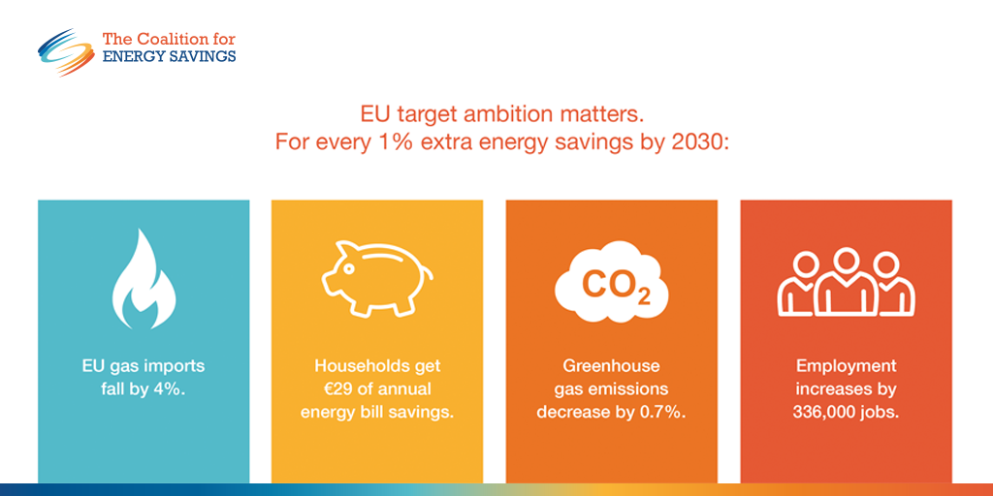
EED Art.3 + Governance Regulation
Increase overall energy efficiency ambition
The higher the energy efficiency target, the higher the benefits for citizens and businesses.
A 40% energy efficiency target for 2030 would trigger an increase of buildings renovation rate to almost 3%

Slide 9
EED Art.7
Stronger energy savings obligations to deliver renovations
BREAKDOWN OF ART. 7 SAVINGS BY SECTOR
Art. 7 as a tool to deliver buildings renovations
Close the existing loopholes to increase the amount of yearly savings (i.e., include transport in the baseline and remove the 25% exemptions)

Slide 10
Key Sources of this Presentation
BPIE, “Renovation Strategies”, available at http://bit.ly/2lKpKQM
BPIE, “Building renovation passports – Customised roadmaps towards deep renovation and better homes”, available at http://bit.ly/2mrODDV
Catrin Maby, Louise Sunderland and Rod Janssen, “Efficiency First means Consumers First: the crucial role of energy advisory services in realising the EU’s energy ambitions”, available at http://bit.ly/2lNrWGn
Yamina, Saheb, “Energy Transition of the EU Building Stock - Unleashing the 4th Industrial Revolution in Europe”, available at http://bit.ly/2lKjTe8
Coalition for Energy Savings, “Energy efficiency policies. Making the Energy Union work for citizens”, available at http://bit.ly/2lNjdDY
Ricardo Energy & Environment, “Study evaluating progress in the implementation of Article 7 of the Energy Efficiency Directive”, available at http://bit.ly/2m84zux

Slide 11
Thank you
avitali@wwf.eu
www.wwf.eu

