Slide 1

It’s More Than Renovation…
A Presentation by
Adrian Joyce
Campaign Director
Buildings Briefing at European Parliament – 10th March 2017

Slide 2
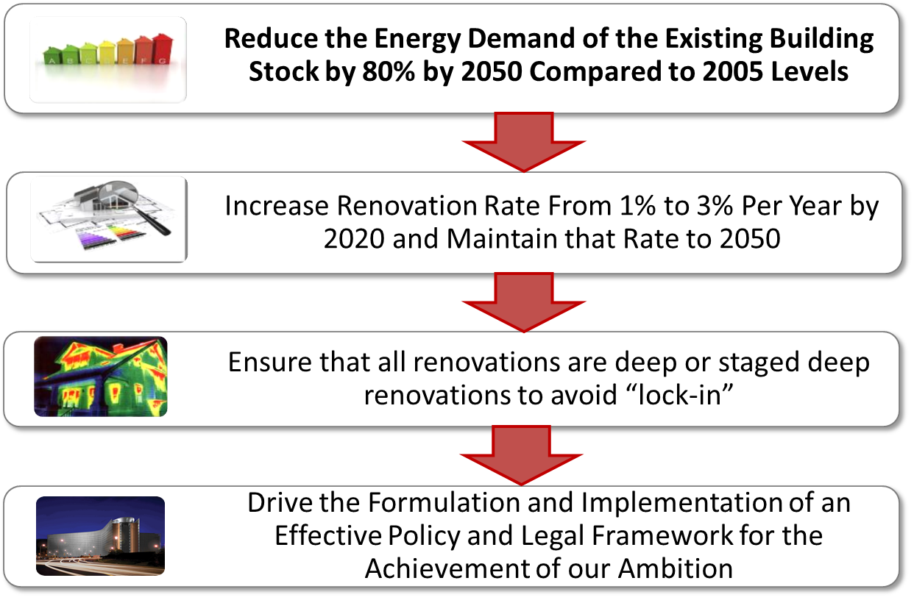
About The Campaign
Buildings Briefing at European Parliament – 10th March 2017

Slide 3
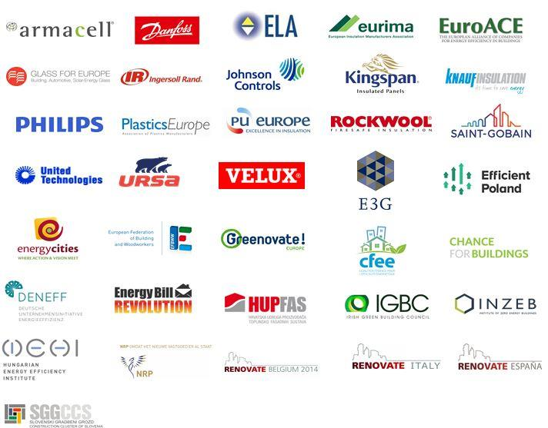
Partners of The Campaign in 2017:
14 National Partners!
Buildings Briefing at European Parliament – 10th March 2017

Slide 4
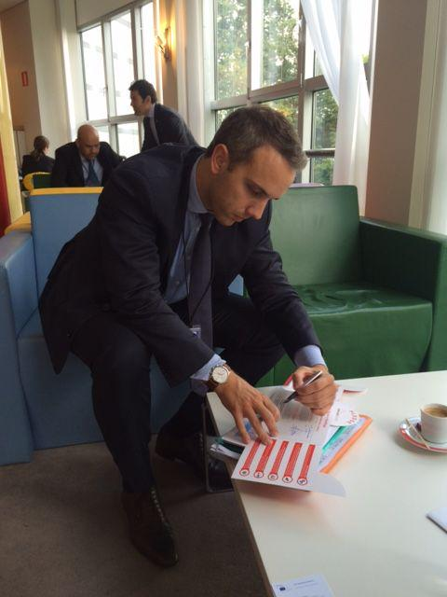
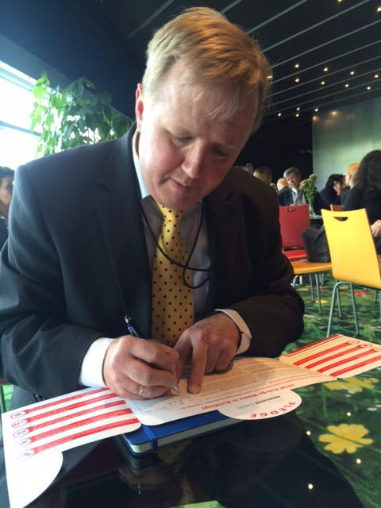
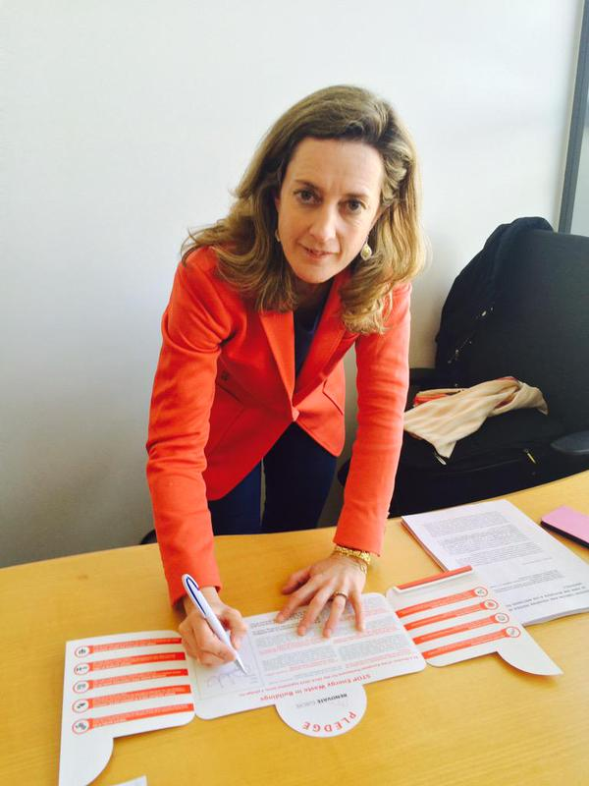
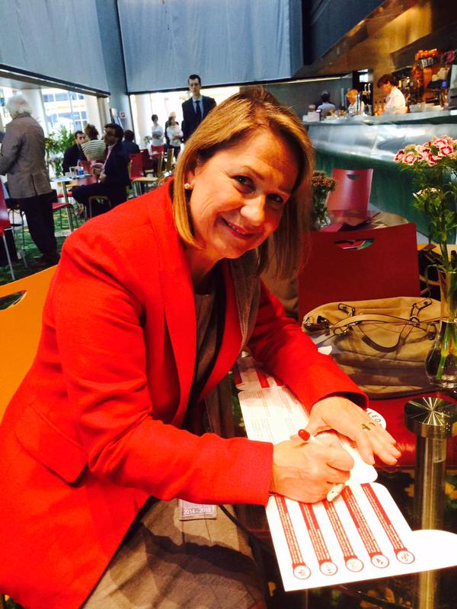


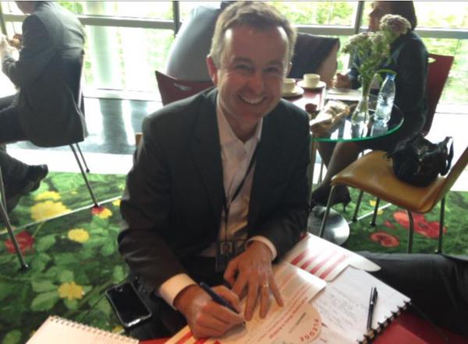

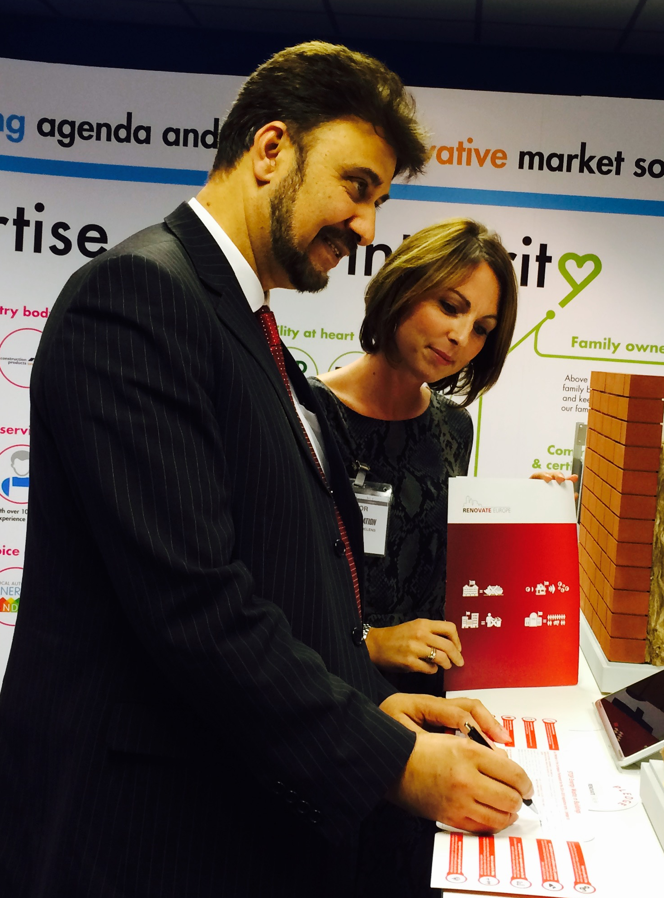
European Parliament Support
97 MEP’s Support our Campaign
From 22 Countries and
7 Political Groups
Buildings Briefing at European Parliament – 10th March 2017
Notes:
I will briefly recall the manifesto of the REC and our efforts around the European elections in 2014 saying that not only have MEP’s been willing to continue to sign up for our pledge, but many of them took part in our new communications activity on the question of why do you support Renovate Europe which is displayed on the walls of the conference room.

Slide 5




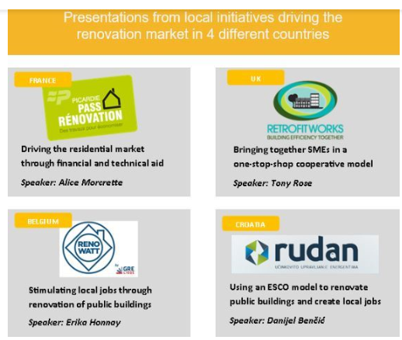



Renovate Europe – Some Activities
Buildings Briefing at European Parliament – 10th March 2017

Slide 6
…Its Energy Security
EU Imports 53% of its Energy Needs
Cost of Imports: More Than €400 billion per year
June 18th = EU Energy Dependence Day in 2015
Deep Renovation Reduces Demand
Push EU Energy Dependence Day Back
1% Increase in Energy Efficiency reduces Gas Imports by 2.6%
Buildings Briefing at European Parliament – 10th March 2017

Slide 7
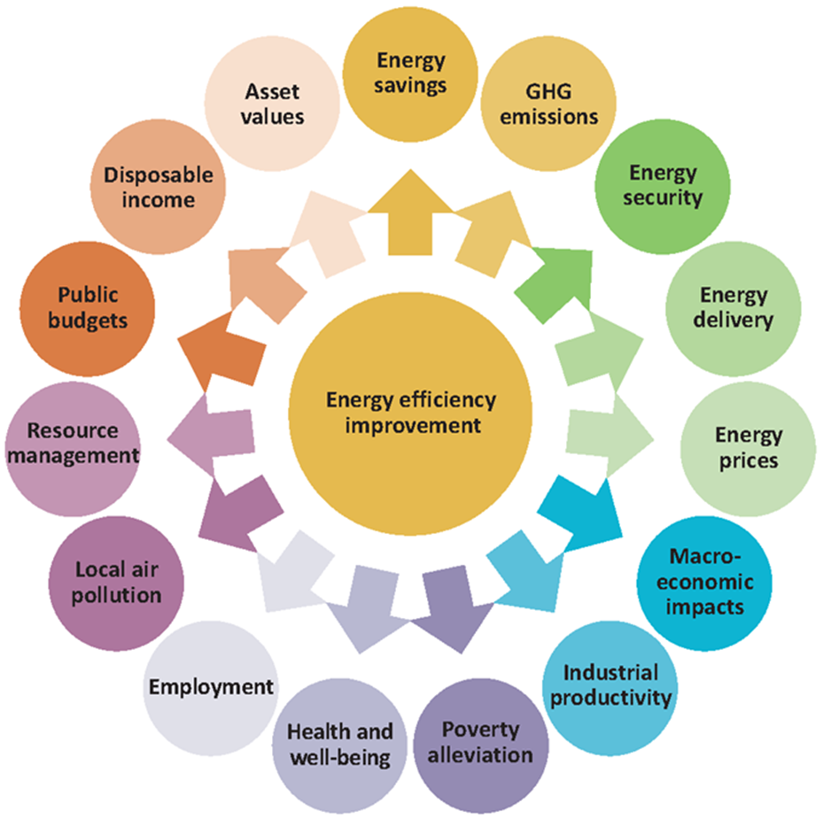


Slide 8
…Its An Investment Opportunity
Investment Need = €100 billion Per Year
Equates to About 0.7% GDP
Rate of Return 11-14%
Savings From Day One Across the Life of the Building
Suitable for Institutional Investors
See EEFIG Report and DEEP database (7,800 examples)
Buildings Briefing at European Parliament – 10th March 2017

Slide 9
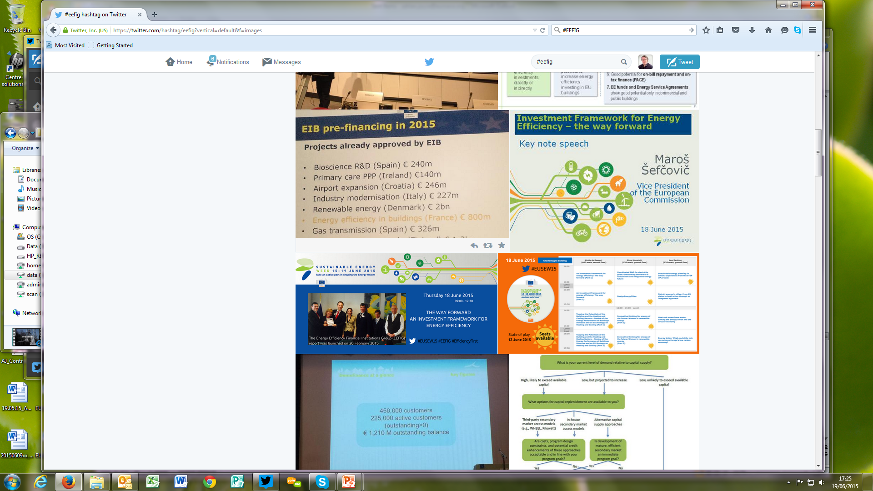

Slide 10
…Its Local Jobs And Growth
BPIE Modelled a Deep Renovation Scenario
Average New, Local Direct Jobs = 1.1 million
Peak In Job Creation, 2020 = 2 million jobs
Equates to Average of 19 Jobs Per €1 million Invested
Does Not Include Indirect Jobs
Leads to Growth in GDP of About 0.7% Per Year
Buildings Briefing at European Parliament – 10th March 2017

Slide 11
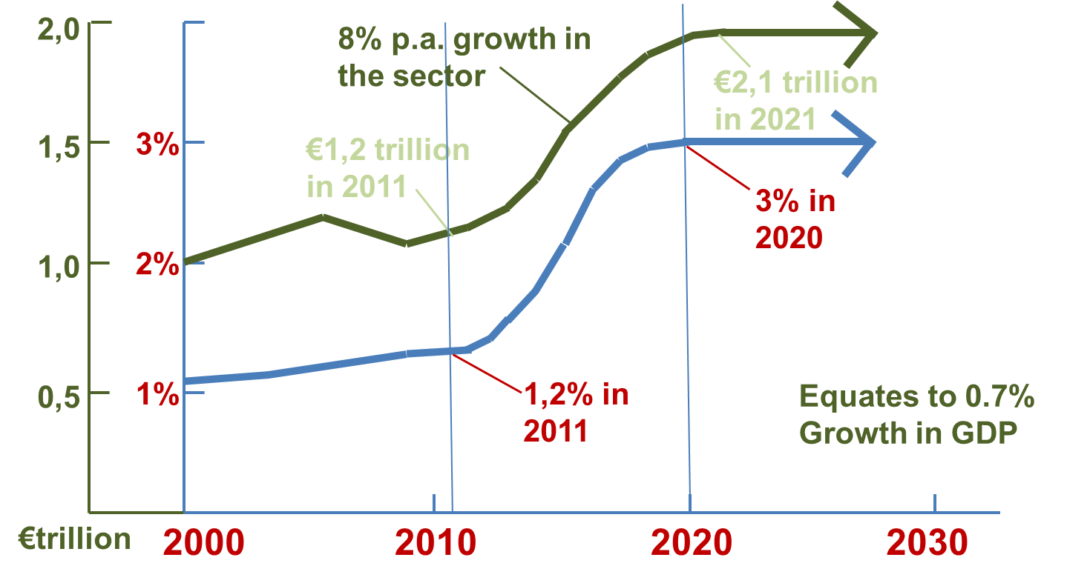
INCREASE IN TURNOVER
INCREASE IN RENOVATION RATE
Buildings Briefing at European Parliament – 10th March 2017

Slide 12
…Its Health And Well-Being for Consumers
Better Indoor Environment
Better Health and Productivity
New Zealand Health Ministry Pays for Renovations
Copenhagen Economics Study
Monetary Benefits = 2.5x Energy Savings
Irish Government Running a Pilot Scheme on Health Effects
Buildings Briefing at European Parliament – 10th March 2017

Slide 13

Buildings Briefing at European Parliament – 10th March 2017

Slide 14
…Its Smart Development
Delivers Multiple Benefits – Drives Economic Prosperity
Resilient to Future Change
Reduces Peak Loads in Energy System
Smart Buildings Use Less Energy
Foundation of Smart Districts and Cities
Increases Property Value (+1% per one-step improvement)
Buildings Briefing at European Parliament – 10th March 2017

Slide 15

Buildings Briefing at European Parliament – 10th March 2017

Slide 16
…Its CO₂ Reductions
Buildings are Responsible for 36% CO₂ Emissions
Achieve an 80% Reduction in Energy Demand
Reduce CO₂ Emissions by 28%
Large Potential Impact on Climate Negotiations
But Buildings Hardly Considered – Now is the time!
An Overlooked Benefit?
Buildings Briefing at European Parliament – 10th March 2017

Slide 17


Slide 18
Concluding remarks : where to focus in the package to enable co-benefits ?
    Ambition in EPBD to be compatible with Renovate Europe: 80% goal for 2050
Focus on reducing energy demand first
Alignment with nZEB principle in new build & renovation
Shared common goal for 2050 to leverage renovation strategies
    National renovation strategies need to deliver more and factor in multiple benefits
      Increased productivity at work; learning abilities at school, etc…
      Reduction in healthcare costs; maintaining elderly at home, etc…
      Reduction in energy infrastructure cost (reduced peak load)
Citizens should be more aware of all these benefits as this will drive more and better action
      Via stronger EPCs, building renovation passports, renovation advice
      More meaningful renovation: savings, comfort, health etc…
      Improving Green value requires good planning & processes
    Financing can help unleash better multiple benefits (Smart Finance for Smart uildings)
      Tackling fuel povery through dedicated funding & planning
      Linking financing to ambition = encouraging projects that deliver more for citizens & society
The higher the ambition in EPBD, the better the planning of renovation strategies, the more aware citizens become of all these benefits, the more likely the Clean Energy Package will deliver these co-benefits for all

Slide 19

www.renovate-europe.eu

